Slide 1
How can quantum physics correspond to consciousness?
Ian Thompson
with the
Theistic Science Group:
Gard Perry, Ron Horvath, Andy Heilman, Steve Smith,
Reuben Bell and Forrest Dristy
Version 7

Slide 2
Outline
There are two problems presently unsolved:
  Quantum measurement problem
  How animals quickly recognize external objects
Some materialist proposals
How should we understand this from the Writings?
Possible correspondences linking sensory ⇔ quantum
Starting a new theory of sensing and recognizing

Slide 3
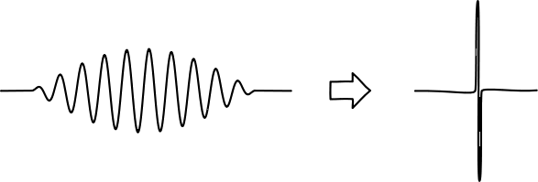
Quantum measurement problem
Contrast between classical and quantum waves:
  Classical waves (e.g. air or ocean) affect everywhere where that wave is
  Quantum waves (e.g. electrons or light) affect only one place in where that wave is.
Why?
Problem also known as:
  “Reduction of the wave packet”
  “Selection of actual outcome”
  ”Reducing a superposition of alternatives to only one actually occurring”

Slide 4
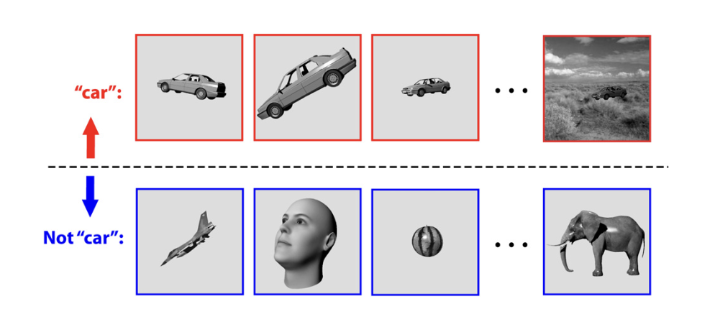
Sensory object-recognition problem
Humans and animals quickly recognize visible objects
  Do this despite varying distance, rotation, lighting, movement, etc.
  Do this within 1/10 second: only ~ 100 neural steps possible.
This is done in the
sensory mind.
How?
Figure from Rudrauf et al, J.Theo.Bio. 428 (2017) 106

Slide 5
Materialist Proposals to solve the Quantum Measurement Problem
Is there a quantum limit to one of these properties?
Maximum distance within superposition (Einstein in 1930s)
Maximum energy difference (Maxwell)
Maximum gravitational energy difference (Penrose)
Maximum complexity (Weingarten)
Some new spontaneous mechanism (Ghirardi, Rimini, Weber)
All making quantum physics a bit more classical.
More details in chapter 12 of my book “Philosophy of Nature and Quantum Reality”,
http://www.generativescience.org/books/pnb/pnb.htm
But very difficult to find any limit experimentally: nothing found yet!
Notes:
Any

Slide 6
Materialist Proposals to solve the Sensory Object-recognition Problem
This the problem in cognitive psychology, of proposing a mechanism to do object recognition.
Two kinds of proposals:
  Progressing extraction of abstract properties, such as edges > lines > boundary curves > 3D objects. (bottom-up)
  Getting proposed scenes from a predictive mechanism, and then quickly adjusting its inputs until agrees with view. (top-down)
Both of these kinds require lots of ‘neural computation’.
  There might be enough neurons in the brain,
  but difficult to get them to coordinate quickly enough.

Slide 7
From Principles of the Writings
GP
Quantum physics is entirely in the physical world. Whatever local causes and effects it deals with must be physical.
The physical cause of the wave function collapse can itself be caused by interior (non-physical) cause
  operating on higher/interior discrete degree in physics.
The interior degree is non-material (spiritual)
  Does not require the presence of a human to operate.
Starts to solve the Quantum Measurement Problem

Slide 8
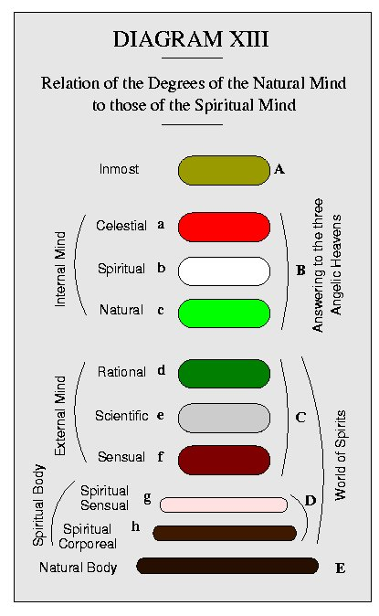
Place of the sensory mind. A reminder
There is a whole cascade of discrete degrees though the spiritual and natural worlds.
  All of them have their own roles in preparing for actual results in the physical.
  Sensory awareness is the very outmost mental degree of the external mind (f here).
Picture from N.C. Burnham’s
book “Discrete Degrees”, 1887.
theisticscience.org/books/burnham/index.htm

Slide 9
‘Consciousness’ in the Writings
A reminder
The power to do anything, or create something
  is love in conjunction with wisdom:
  that power of creating.
  Not ‘awareness’ or ‘consciousness’ by itself
What then is ‘consciousness’ in the Writings?
  The manner in which love and wisdom operate together: DWis 6, 7.
  Personal consciousness only arises after birth when lungs-and-heart operate together like love-and-wisdom.

Slide 10
Uses of discrete degrees
These things must be useful in order to exist.
  Every discrete degree needs some kind of ‘event’ in order to justify existing: by doing something useful.
So to be useful:
  The outermost quantum discrete degree
    cannot be pre-determined,
    but must have its own selection events (even if random! QM!)
  The outermost sensory degree
    has to be linked with actual physical things (to see them!)
    has to select among possible objects to recognize what it sees
    (where sensory consciousness is, if love+wisdom give sensations)

Slide 11
What the Writings suggest:
Every operation of love acting by wisdom
(producing consciousness) corresponds with
an actual selection in nature (i.e. in quantum mechanics).
  This is a joint event that connects two discrete degrees.
  These loves could be divine, in animals, or in humans.
  Such events are needed in creation before animals existed.
The last physical degree is terminating and fixed.
  Makes a foundation for higher discrete degrees.
  Not itself conscious.
  This is the location of definite quantum selections
Notes:
The

Slide 12
How conscious actions correspond with physical selections
Correspondences are from the joint events.
Caused by influx from one degree into another.
The influx could be from a person into the body, specifically from the sensory mind into the brain.
  But instant influx is received as a moment in the physical *
  (A moment = a non-zero time duration)
  This could be the time between measurements that allows superpositions to spread out and exist.
* smaller Index to Angelic Wisdom concerning Marriage (60) under ‘Influx’.

Slide 13
Use of Joint Selections?
Quantum selections make an actual choice between all the possibilities within the range of the wave function.
Sensory selections make a choice between all past things experienced when some part or property is sensed again.
Need for a new kind of asymmetric joint operation,
  to project simultaneously on the brain and on the sensory mind, but with all probabilities given by quantum mechanics on the neural side.
  to quickly transmit sensory information from the brain to the mind.
ISB 1: According to order for the thinking mind to flow into the sight according to the state induced on the eyes by the objects before them

Slide 14
A new theory about sensory minds
- Starting to solve the Sensory Object-Recognition Problem
A theory of object recognition based on correspondences with quantum physics:
Sensory memory stores a very large number of object-property pairs in its initial mental ‘quantum state’.
All possible spatial translations, rotations (etc) generate further superposed mental pairs of the object with its possible views.
Sensory input from the physical world leads to a particular measurement-selection of the neural brain state as well as of the mental quantum state. The object in the selected pair is thus the one with a view most likely matching what is seen.
This can give a fast recognition of observed objects.

Slide 15
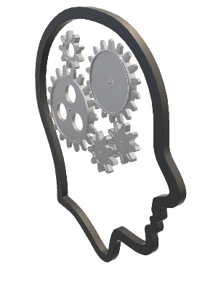
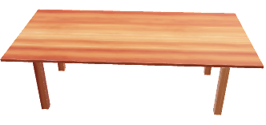



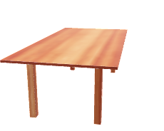


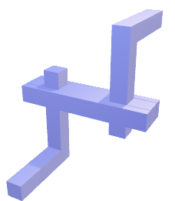
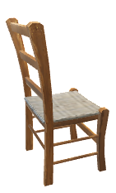
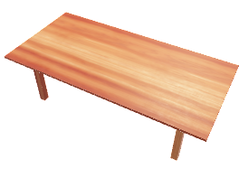
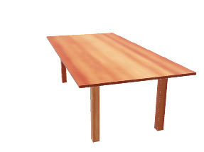
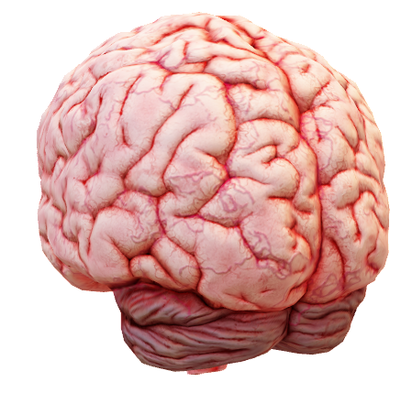
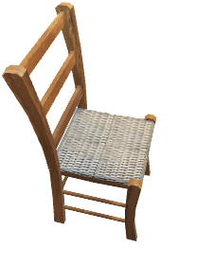
Conscious Object Recognition by Quantum Selection
External
World
Physical
world
Mental
world
Inner
mind
Eyes
Possible
objects
Actual
view
Mental
light
possible
Current
objects
(short
term
memory)
views
Narrow range
of views allowed
by eye input
Visual
cortex
Superposition of reflected light
from all possible + current objects.
Actual view selects recognized object:

Slide 16
The Way Forward
The puzzles of the quantum physics measurement problem have been around for a long time.
Maybe we should see it as really two discrete degrees.
By seeing multiple discrete degrees in action,
we use correspondences to make better theories about those degrees – without losing what is distinctive and useful at each level.
We begin a theory of quantum-like sensory minds with fast associative recall and object recognition.

Slide 17
Alongside our earlier theory
Postscript
How spiritual influx shows itself in physics
by means of modifying some of the
‘constant’ parameters in physics
(like charge or electric permittivity).
See New Philosophy, Vol 121, pp 284-294 (2020)

Slide 18
Role of God here
GP
God operates everywhere throughout the physical universe.
  God is not in time and not in space.
  God is present non-temporally and non-spatially.
God is able to ‘see’ both super-position and collapse of the wave function
  As God can be present to physical substance without violating God’s own laws of order.
This occurs whether or not a human being is present to observe it.

