Slide 1
Starting Science From God 1: Connecting Science and Theism
www.beginningtheisticscience.com
Ian Thompson
Visiting Professor of Physics, University of Surrey, England.
Currently employed at Lawrence Livermore National Laboratory.
www.ianthompson.org
Disclaimer
This material is not supported or authorized by any of the organizations or institutions at which he is employed and/or with which he is affiliated.

Slide 2
A series of four evenings
Titles:
Feb 5: Connecting Science and Theism (chs 1, 3)
Feb 12: Discrete Degrees (chs. 4, 5)
Feb 19: Explaining Theism (Part III)
Feb 26: Applications to Theistic Science (Part V)
I talk for 45 mins (answering shorter questions).
This is being video-taped. Not too much noise please.
Refreshment break for 15 mins
Discussion for 45 mins (for longer questions)

Slide 3
1. Connecting Science and Theism
Topics for today:
Theism has empirical consequences
It can be tested, and so is scientific.
Explore theism as an alternative to naturalism
Principles of Theism
Science should allow causal effects beyond the physical
Religion should allow a God of unselfish love.
Some history, and some contemporary proposals.
Topics for later talks

Slide 4
Theism has empirical effects?
Opposing view:
‘non-overlapping magisteria’ (NOMA)?
Science = ‘what is’ and
Religion=‘what should be’
Protects religion from science & vice versa
But NOMA has serious defects:
If we are to know God, God must influence us.
Religion & theism do talk of what is!
How we live. Human nature (soul?). Religious history (revelations, incarnation), etc.
There are overlaps!

Slide 5
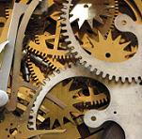
Modern Naturalism
Tries to allow only physical explanations
Looks for mechanisms
Does not rely on anything about God
But has big difficulties still:
Cannot yet explain minds & consciousness
Cannot yet explain origin of life & its informational basis.
So it is a ‘Promissory Materialism’
But: how long should we wait? 50 or 500 years?
This: we should try alternatives now!
Should make new theories of mind, etc.
To compete with existing science research programs

Slide 6
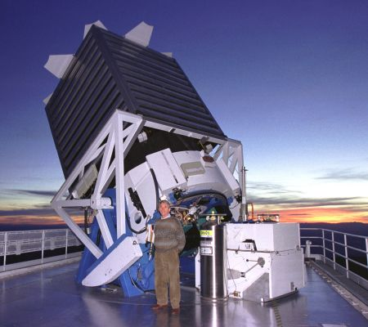
Requirements of Science
Should accept the best explanation
But: science still needs overall theory
Theory to explain how to observe
Theory to explain how causes operate
Science should not prejudge its starting point:
The conclusion about ‘what exists’ should depend on results of investigations
So: different `overall theories’ should be allowed.

Slide 7
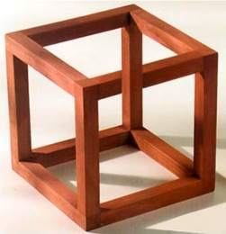
Try to make ‘Theistic Science’
Start from postulate that There Is a God
In contrast to naturalism’s “no need for God”.
Clarify the basic postulates of theism
No paradoxes allowed.
Keep a rational consistency!
Should be non-reductionist:
Do not make minds ‘nothing but’ the brain.
Make predictions to compare with experiments
Supported if predictions are confirmed

Slide 8
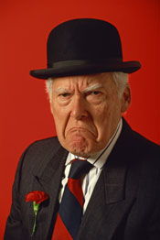
Some Scientific Objections to Theism
If God were allowed as an explanation in science, then ‘anything goes’.
The explanation of ‘God did it’ could be used for any event whatsoever, however regular or irregular and however comprehensible or incomprehensible.
Reply: God is not some arbitrary and capricious old man who can do what he likes.

Slide 9
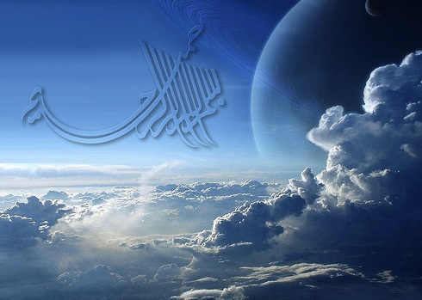
Allowing a Scientific Theism
The previous reasons for opposing theism in science arise from misunderstandings about the nature of God.
We already know that there are considerable regularities in the world, so we should instead explain the source, nature and reasons for those regularities.
That source, for example, might be the constancy and eternality of the love and wisdom of God.

Slide 10
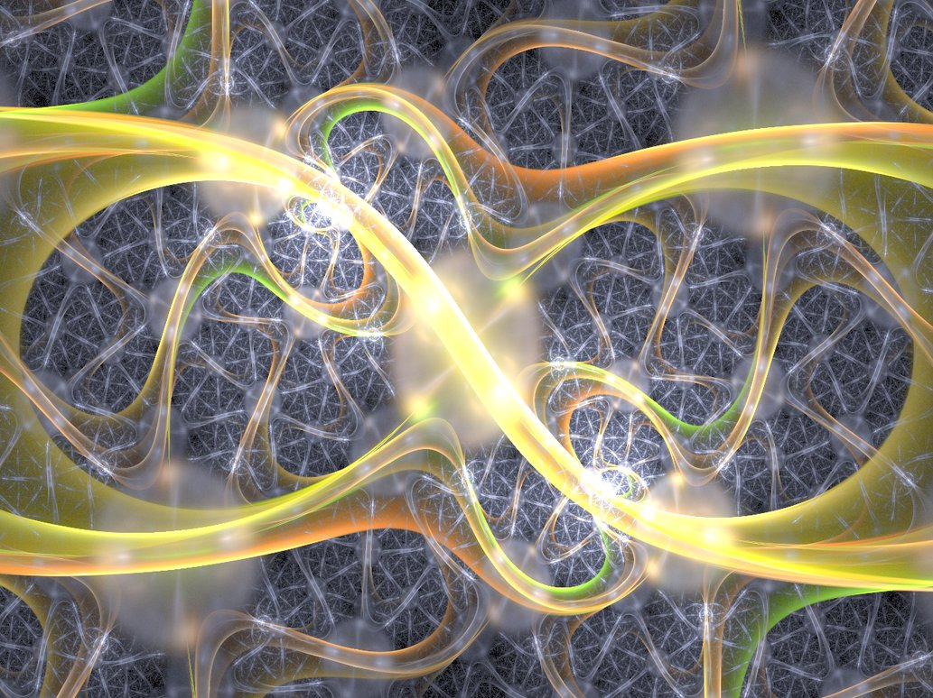
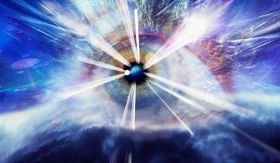
Where to begin Theism?
‘God is an eternal, omnipotent, omniscient being who created & sustains the world’.
But these attributes do not have specific consequences for minds & spirit!
We want the ‘God of the Living’, not just ‘God of the Philosophers’.
Better ‘Living theism’:
God is that Person who is a necessary being, who is unselfish Love itself, Wisdom itself, and (in fact) Life itself.
God enlivens our world.

Slide 11
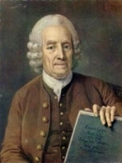
Essential Theistic Principles
God is love which is unselfish and cannot love only itself.
God is wisdom as well as love and thereby also power and action.
God is life itself: the source of all dispositions to will, think and act.
Everything in the world is a kind of image of God: all minds and also natural objects of all kinds.
Our life from God derives from divine power, depending on us.
This set was suggested first by Emanuel Swedenborg in his book “Divine Love and Wisdom” (1763)

Slide 12
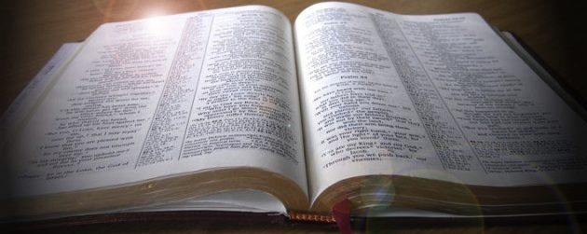
Religious Support for Postulates
Love: “God is Love” 1 John 4:8
Wisdom: “the Lord gives wisdom, and from his mouth come knowledge and understanding” Proverbs 2:6
Life: “the Father has life in himself” John 5:26
Image of God: “God created man in his own image” Genesis 1:27
Our life is from God: “The free gift of God is eternal life” Romans 6:23

Slide 13
Questions to be answered
How can there be a Personal God, a Living God?
Is the world a monism, dualism, or many levels?
If many, what multiple levels or planes of existence are there?
What are the mind-body connections between fully-existing minds and brains?
How do physical, biological and mental structures come into existence?
Are they created, gradually developed, or evolved?

Slide 14
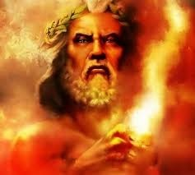
Adjusting Religion
God is a being composed entirely of Love, and, moreover, a completely unselfish love.
Anger, jealousy, exclusiveness and selfishness are completely foreign.
But God is often portrayed as angry or jealous!
Rather: it is our variations which lead to God having varying appearances to us.
Psychology (to be confirmed):
when we are angry, God appears angry with us.

Slide 15
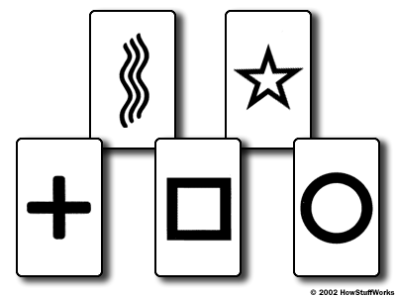
Adjusting Science
Allow physical processes to depend on our individual minds, or even on the transcendent mind of God.
Do not refuse even to consider evidence, because of a denial in advance of such dependence.
Do not be frightened by new ideas.

Slide 16
What does Theistic Science Prove?
There are ‘proofs of God’ starting from what we know about nature in general.
But: I do not argue in a natural theology from nature and science to God.
Theistic Science does not try to logically prove the basic features of theism
Instead, I start from God. I propose to start science from God and theism.
You will see what theistic science looks like.

Slide 17
Preview of Second Talk (Feb 12)
Need concepts of ‘substance’ and ‘form’
Not hidden from science
Applicable to all processes: physical, mental, …
Following approach of Aristotle, but not Aquinas
Need concept of ‘multiple levels’
Use some examples from physics & psychology
Principles of ‘Generation and Selection’
Usable to connect the physical & mental
Concept of ‘Discrete Degrees’ will be useful

Slide 18
‘Substance’ and ‘form’ in history
Plato : forms are eternal, but we trapped on earth
Aristotle: form & substance & change all essential
Aquinas : matter is inert & minds are forms
Newton : theory of matter under God of theism
Leibniz : God & minds don’t interfere in nature
Swedenborg: Discrete degrees & spiritual can be known
Kant : Spiritual things cannot be observed
since then, science has ignored spiritual causes.
For now: use Aristotle’s principles, but more generally

Slide 19
Some bad proposals
Theism & spirits & minds act (not!):
Abstractly
Are ‘active information’ (or any information)
In a 4th dimension (or 5th)
At a high ‘frequency of vibrations’
Outside time
A ‘fine’ or ‘subtle’ substance in physical gaps
Are ‘system wholes’
Are cosmically ‘large’ as ‘expanded consciousness’
According to quantum physics

Slide 20
Contemporary Bad Proposals
Chaos theory (Polkinghorne)
Sensitivity to starting conditions means that physics can never predict completely accurately.
Quantum measurement (Chopra)
Minds influence brains by non-local correlations
Quantum vacuum (Chopra, Laszlo)
Vacuum ‘behind reality’ is consciousness
Panpsychism (Whitehead, and now Wilber)
Everything has some psychic component

Slide 21
End
We have discussed:
How to relate science and theism
Making a Theistic Science
Principles of Theism
The need to understand ‘substance’
Other attempts to link these things.
See you next week at the same time!

