Slide 1

Starting Science From God
2: Discrete Degrees
www.beginningtheisticscience.com
Ian Thompson
Visiting Professor of Physics, University of Surrey, England.
Currently employed at Lawrence Livermore National Laboratory.
www.ianthompson.org
This material is not supported or authorized by any of the organizations or institutions at which he is employed and/or with which he is affiliated.

Slide 2
A series of four evenings
Feb 5: Connecting Science and Theism (chs. 1, 3)
Feb 12: Discrete Degrees (chs. 4, 5)
Feb 19: Explaining Theism (Part III)
Feb 26: Applications to Theistic Science (Part V)
  I talk for 45 mins (answering shorter questions).
  Refreshment break for 15 mins
  Discussion for 45 mins (for longer questions)

Slide 3
2. Discrete Degrees
OUTLINE
Better idea of ‘substance’?
  Realistic basis need for all kinds of things
  The power/propensity/dispositions of objects
  Concept of mental substance
Better idea of ‘multiple degrees’ of existence?
  Like ‘dimensions’ or ‘planes’, but better
  Examples from physics
  Examples from psychology
  General principles: generation & selection
  See connections between levels
Both ideas came from using Swedenborg to understand modern science!
Particular conclusions to remember: see the ✪ sign

Slide 4
A. Bad ideas of mental substance
Matter (materialists, physicalists)
Rationality (Descartes)
Immaterial Form (Aquinas)
Information (Bohm?)
Pure Being (nondualists)
Quantum vacuum (Laszlo)
Consciousness (what does it do?)

Slide 5
Substance, Form, and Dynamics
Back to basic analysis:
There are three categories of terms in science:
  formal terms
    about the structure & static properties of what exists now
  existential terms
    about what exists, what is. Is it unknown?
  dynamical terms
    about what would happen, in new and/or hypothetical conditions.
    Only by dynamics, can we make predictions.

Slide 6
Three Categories: more examples
Form
shape, number, form, relation, configuration,
function, field, oscillation, wave, flow, vibration
point, length, area, volume, amplitude,
vector, matrix, Hilbert space,
ratios, probability, relative frequency.
Existence
particle, material, matter, corpuscle, body,
fluid, ether,
substance, actuality, reality,
experience, observation,
world, universe.
Dynamics
cause, propensity, power, disposition, capability,
energy (kinetic and potential),
mass, charge, field coupling,
force, pressure,
momentum, impetus, elasticity/rigidity.
MATHEMATICS
ONTOLOGY
PHYSICS
All three categories are needed, in order to describe:
What exists, Its Form and Its Behavior. ✪

Slide 7
Three Categories: more examples
All three categories are needed, in order to describe:
What exists, Its Form and Its Behavior. ✪

Slide 8
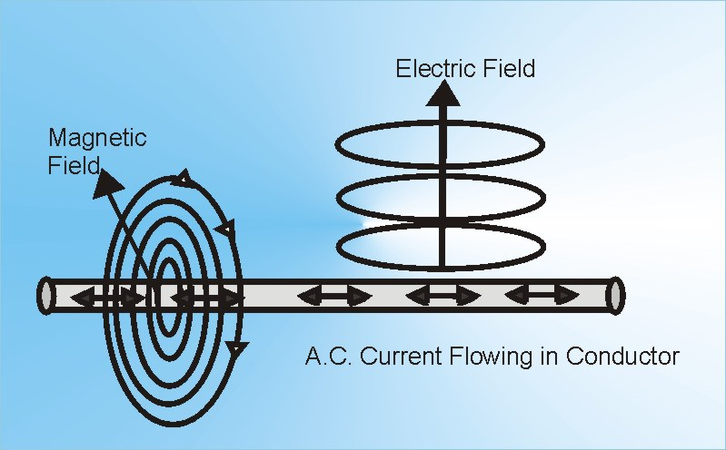
New idea: ‘Dynamic substance’
Try to derive ‘existence’ from ‘dynamics’:
Substance of a thing is its propensity (to do some thing) ✪
Examples:
  ‘electromagnetic force field’,
  ‘potential energy field’
  ‘matter is a form of energy’
  quantum wave function is a ‘propensity field’
    propensity to interact, or
    propensity to choose actual outcome
Remember: propensities still present even if not acting ✪
  Do not need to know more ‘existence’ than this.
  Maybe not that original!
    Aristotle and Newton used something similar

Slide 9
Mental Substances (minds)
Works for minds too:
    Not something ‘we know not what’!
Mental substances are the propensity for mental actions
That is: loves, desires, etc. are mental substance ✪
Even materialists (eg Gilbert Ryle) agree that ‘minds are dispositions’.
  but now we take them as real substances.
Agrees with Swedenborg that
‘Love is the substance of man’ ✪
DLW43: “Divine Love and Divine Wisdom in themselves are substance and form”

Slide 10
Bad ideas of mental substance
Immaterial Form (Aquinas)
Rationality (Descartes)
Matter (materialists, physicalists)
Information (Bohm?)
Quantum vacuum (Laszlo)
Consciousness (what does it do?)
Why? ✪

Slide 11
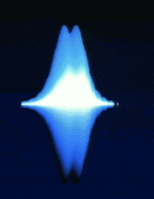
Quantum Physics
There are probabilistic (random) events.
  From a wave function spread out in space
  Wave function from an equation about energy
Now:
the wave function is the form of propensity
  The propensity for probabilistic events
  That propensity is substance of quantum objects✪
No particles, only ‘waves of propensity’ ✪
The propensity is the substance, wave is the form

Slide 12
Two stages in Quantum Mechanics
‘Active Energy’
Propensity Wave
Actual Outcome
(Hamiltonian Operator)
(Wave function)
(Measurement)
Schrödinger Equation
Born’s Probability Rule
Propensity wave generates the actual measurement
  according to Born’s Probability Rule for |ψ|²
Actual measurements = selections of alternate histories
Energy operator generates the wave function,
  according to Schrödinger’s time-dependent equation
So: ‘Energy’, ‘propensity waves’ are two kinds of propensity ✪
Neither are mental propensities! ✪

Slide 13

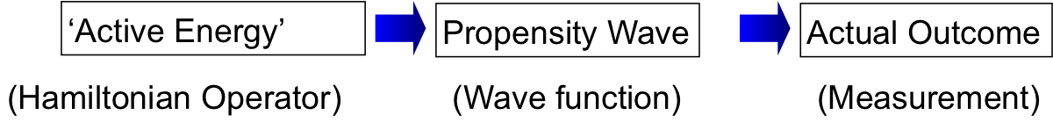
Bad ideas about Quantum Physics
Shut up and calculate (physicists)
  No reality
Physics just for actual outcomes, not reality (Bohr)
  No propensity or substance
Parallel universes (Everitt)
  No actual outcomes
Hidden classical particles (Bohm)
  Quantum waves are not substances
Selection by consciousness (Wigner)
  Propensities are for selections. But maybe ‘when’?
Rather:

Slide 14
B. Multiple ‘degrees’ of existence
Show new concept for how minds and matter are (a) separate and (b) interrelated !
Later: use concept to show how God and creation are (a) separate and (b) interrelated !
This idea comes from Swedenborg
  New illustrations from physics & psychology

Slide 15
How Mind and Matter related?
Matter causes mind only? matter⇒mind
  Epiphenomenalism or dual-aspect physicalism
Mind causes matter only? mind⇒matter
  ‘new age’ or ‘we create our own reality’
Mind and matter in parallel? mind⥣matter
  Pre-established harmony: Leibniz. Correspondences?
Mind and matter interact mind⥂matter
  Descartes (Body ↔ Soul)
  Causes in both directions, but not in same way ✪
  Swedenborg (many discrete degrees)

Slide 16
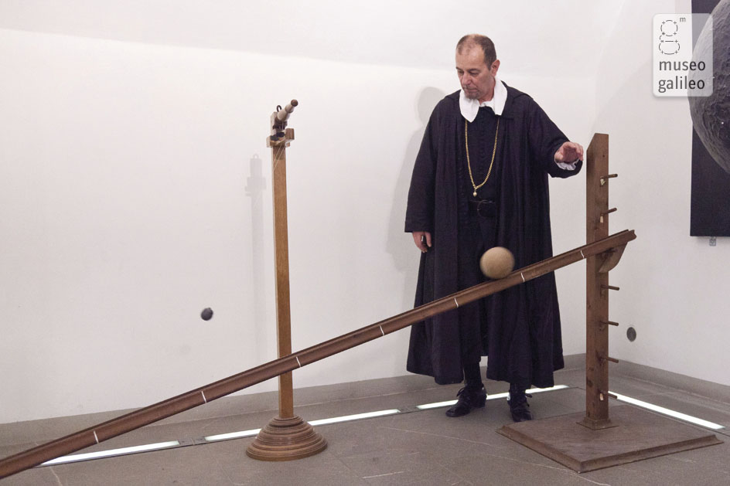
Degrees in Galileo’s experiment
Remember how a ball rolling down a hill is accelerated by gravity (Galileo’s experiment)
Newton’s second law: F=ma
  So: acceleration (a) = force (F) / mass (m)
  But: acceleration is present only if mass is there!
  So: force = disposition
  to accelerate a mass
  (if finite mass present)
Presence of inertial mass
is occasion for motion,
but not principal cause

Slide 17
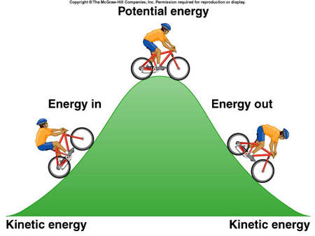
Multiple degrees in Newton’s physics
Ball rolling down a hill is accelerated by gravity
Gravitational energy:
  Force depends on the slope
  Changes in gravitational potential
  energy produce the force ✪
Potential energy
Force
Acceleration
(Gravitational energy)
(Forces add)
(Actual result)
Newton’s Law of Gravity
Newton’s Second Law F=ma
Again, we see two stages of the operation of propensities.

Slide 18
Multiple degrees in psychology
In deliberate control of hand movements
  Deliberate (rational) intentions (D)
  Monitoring of moving hand, by eyes (P)
  Control of muscles (M)
Psychologists make theories about:
“Cascading Intentions” ✪
D ➔ P ➔ M ➔ overt action
Elisabeth Pacherie (2008)

Slide 19
Recognizing Discrete Degrees
Quantum mechanics:
  Energy ➔ Propensity ➔Actual Selections
Classical physics
  Potential energy ➔ Forces ➔ Acceleration
Psychology of motor control
  Plan ➔ Guidance ➔ Motor impulse ➔ Physical act
All these are example of Discrete Degrees ✪

Slide 20
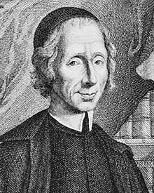
Principles of 2 Discrete Degrees
Consider: A ➔ B
A generates further existence of B
Which new B is generated by A, and is selected by previous B
Twin processes of generation and selection ✪
  Generation is from the ‘higher’ degree: ‘principal cause’
  Selection is from the ‘lower’ degree: ‘occasional cause’
With only two degrees like here, we have ‘occasionalism’
  For God, this is philosophy of
  Nicolas Malebranche (1638-1715)
  An attempt to understand God-world relations.
Generation
Imagine
A=our mind, or God
B=physical effects
Two degrees
A
Selection
Time →
B1
B2
B3
Feb 12, 2013
Ian Thompson
20

Slide 21
Principles of 3 Discrete Degrees
A: God
B: Minds
C: Effects
Consider: A ➔ B ➔C
A generates further existence of B, and B of C
  Which new B is generated selected by previous B,
  Which new C is generated selected by previous C.
Three degrees
A
Generation
Selection
Time →
B1
B2
B3
C1
C2
C3
C4
Feb 12, 2013
Ian Thompson
21

Slide 22
Examples of 3 Discrete Degrees
Have from quantum physics
A: principle / energy
B: distribution / form
C: final effect
Just like in the mind:
A: desire
B: thinking
C: action
Three degrees
A
Generation
Selection
Time →
B1
B2
B3
C1
C2
C3
C4
Similar processes of
generation &selection
are in minds,
and in nature ✪
Each degree has
own being
own space
own existence

Slide 23
Quantum Field Theory:
Propensities for Virtual Processes
TWO linked sets each of three generative levels
  both with (broadly) corresponding processes,
  i.e. still in pattern ‘Energy ➔ Wave ➔ Effect’.
Virtual processes (in some way) ‘generate’ the terms of the Energy Operator: the Hamiltonian. (Kinetic & Potential E)
Field Lagrangian
Virtual Quantum Fields
Virtual Events
Virtual
Energy Operator
Propensity Wave
Actual Events
Actual
‘Principle’
‘Cause’
‘Effect’
  More complex structures of discrete degrees should be expected ✪

Slide 24
Preview of Third Talk (Feb 19)
Good concepts of God
  Not metaphorical, or hidden from science
  Being itself, Life itself, Love itself, Wisdom itself
Understanding how we derive from God
  God is being, love, wisdom & life itself
  We derive being, love, wisdom, life from God
  How?
  By ‘generation and selection’, in discrete degrees
End

Slide 26
Generation
Two degrees
A
Selection
M
Time →
B1
B2
B3
‘Active Energy’
Propensity Wave
Actual Outcome
(Hamiltonian Operator)
(Wave function)
(Measurement)
Three degrees
A
Generation
Selection
Time →
A: God
B: Minds
C: Effects
B1
B2
B3
C1
C2
C3
C4

