Slide 1
Starting Science From God 3: Explaining Theism
www.beginningtheisticscience.com
Ian Thompson
Visiting Professor of Physics, University of Surrey, England.
Currently employed at Lawrence Livermore National Laboratory.
www.ianthompson.org
Disclaimer
This material is not supported or authorized by any of the organizations or institutions at which he is employed and/or with which he is affiliated.

Slide 2
A series of four evenings
Titles:
Feb 5: Connecting Science and Theism (chs 1, 3)
Feb 12: Discrete Degrees (chs. 4, 5)
Feb 19: Explaining Theism (Part III)
Feb 26: Applications to Theistic Science (Part V)
I talk for 45 mins (answering shorter questions).
This is being video-taped. Not too much noise please.
Refreshment break for 15 mins
Discussion for 45 mins (for longer questions)

Slide 3
3. Explaining Theism
Topics for today:
Principles of Theism
Argument from Being
Argument from Life Itself
We are images of God in every part
Levels, sub-levels and sub-sub-levels
Questions of correspondences, personal identity, law vs intervention, etc.

Slide 4
Where to begin Theism?
Living theism:
God is that Person who
is a necessary being,
is unselfish Love itself,
is Wisdom itself,
so: Life itself.
God enlivens our world.

Slide 5
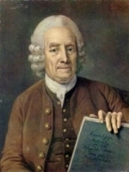
Essential Theistic Principles
0. God exists, and God is One
God is love which is unselfish and cannot love only itself.
God is wisdom as well as love and thereby also power and action.
God is life itself: the source of all dispositions to will, think and act.
Everything in the world is a kind of image of God: all minds and also natural objects of all kinds.
Our life from God derives from divine power, depending on us.
This set was suggested first by Emanuel Swedenborg in his book “Divine Love and Wisdom” (1763)

Slide 6
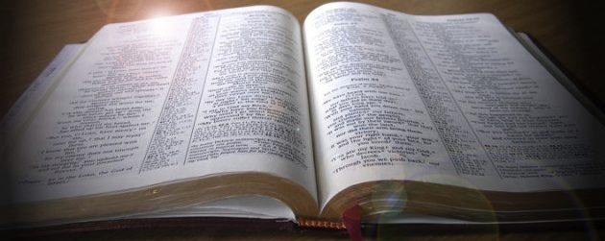
Religious Support for Postulates
Love: “God is Love” 1 John 4:8
Wisdom: “the Lord gives wisdom, and from his mouth come knowledge and understanding” Proverbs 2:6
Life: “the Father has life in himself” John 5:26
Image of God: “God created man in his own image” Genesis 1:27
Our life is from God: “The free gift of God is eternal life” Romans 6:23

Slide 7
Our existence depends on God
God is being itself
We exist
We (as individuals) have being.
Therefore, our being
either is God,
or depends on God.

Slide 8
God is Not Us
God is love which is unselfish
Unselfish loves cannot love itself.
Therefore, we must be distinct from God.
That is: We are separate from God in some way: God is not us.
So: not ‘pantheism’
- when everything is a part of God

Slide 9
God cannot create another god
Suppose God did create something that lived in itself.
Then that thing would have as one of its attributes life itself.
So that thing would have as one if its attributes God.
Then, since God is one, we should conclude:
That thing would not be distinct from God.
We do exist distinct from God (as loved unselfishly)
So God cannot create beings who live in themselves
‘Little gods’ cannot be created.

Slide 10
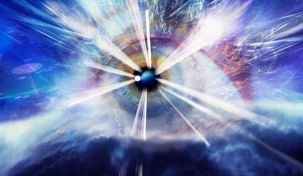
Life and Life Itself
The ‘life of an object’ is the most original generative disposition that gives rise to its capacities and actions.
God is Life Itself
The original source of all powers, capacities and dispositions of objects and persons.

Slide 11
How do we live?
Our being and life depends on God. How?
Our actions are our own
The life we have is derived from God in accordance with what we have already done.
So we can choose when to act
And we enjoy our actions
Our actions are occasional cause
God’s life is the principal cause.

Slide 12
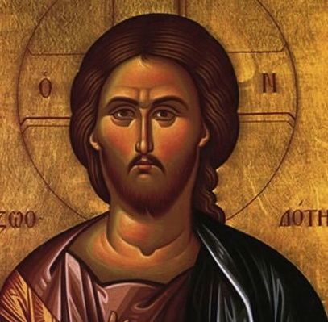
God is Love, Wisdom and Action
God is love which is unselfish and cannot love only itself.
God is wisdom as well as love
God is thereby also power and action.
This is a trinity within God, as one person:
Love is the substance
Wisdom is the form
Action is the resulting act

Slide 13
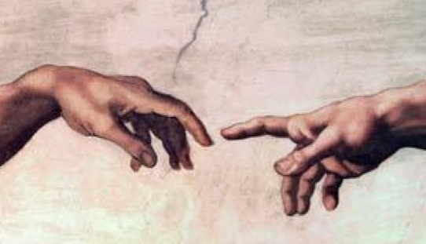
Images of God
All the world, and each of its parts, is a kind of image of God
We are images to greater or lesser extents, depending on our nature and actions.
What is unified and continuous in God, is imaged as discrete distributions
There are in us images from God of Love, Wisdom and Action.

Slide 14
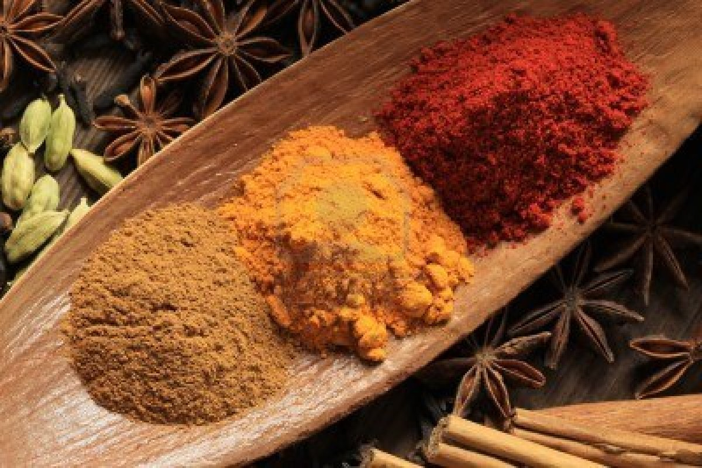
We receive and re-use life
We choose when to act (freedom!)
so we enjoy our actions
This requires us to receive, retain, reuse life
This requires ‘separate containers’ for love, and wisdom and means to action.
These are then combined when we choose.
Name: reception = ‘influx’

Slide 15
Three kinds of reception
Spiritual, to contain the separate loves in creation, including desires, loves, affections, motivations, purposes, dispositions, etc.
Mental, to contain the separate carriers of wisdom, including thoughts, ideas, understandings, rationality, plans, ideologies, beliefs, etc.
Physical, to deal with separate final actions & effects, including the entire sets of things we know from external observations and physics.
The spiritual and mental, together, are often call ‘mind’.

Slide 16
Relations between 3 receptions
God, with the three created receptions, gives a set of four generative levels.
God ⇘ Spiritual ⇘ Mental ⇘ Physical
God generates first the spiritual realm, where there are containing-substances which appropriate and retain love.
Spiritual (of loves) acts by producing new thoughts in the mental realm, where there are containing-substances which appropriate and retain ideas.
Mental (of ideas) acts, in conjunction with the loves from the spiritual, by producing new effects in the final physical realm
Physical (of actions) is the final effect of the chain and is the ‘bottom line’ or termination of all the processes.

Slide 17
Relations between 3 receptions
Lower levels select what can occur:
God ⇘ Spiritual ⇘ Mental ⇘ Physical
Particular existing spiritual containing-substances select which loves from God can be appropriated and retained
Particular existing mental containing-substances select which ideas generated by the spiritual realm can be appropriated and retained.
Particular existing physical containing-substances select which actions generated by spiritual and mental realms can have permanent physical effects.

Slide 18
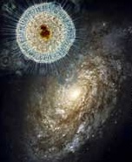
God is Equally Present in All Subparts
God is the same everywhere, at all scales in space and at all degrees and stages of generation.
Same pattern of love/wisdom/effects can be applied at each of the these 3 created generative levels
This produces sub-levels.
Three levels give nine sub-levels (an ennead)

Slide 19
Ennead of sub-levels: form
1: Spiritual degree love in the spirit | 2: Mental degree thoughts in mind | 3: Physical degree actions in the body
Love of loving: 1.1 | Thoughts of loves: 2.1 | Effects from ends: 3.1
Love of thoughts: 1.2 | Thoughts of thoughts: 2.2 | Effects from thoughts: 3.2
Love of actions: 1.3 | Thoughts of actions: 2.3 | Effects from actions: 3.3
Each of these nine sub-degrees describes substances of its own kind which act in distinct spaces.
Within those spaces there can be contact between two objects of the same kind.
These nine substances exist simultaneously and interpenetrate without collision. Note that ‘interpenetrate without collision’ is only a metaphor for the relation of the nine spaces.

Slide 20
Ennead of sub-levels: content
Spiritual | Mental | Physical
1: Spiritual degree love in the spirit | 2: Mental degree thoughts in mind | 3: Physical degree actions in the body
Love of loving: 1.1 Celestial heaven | Thoughts of loves: 2.1 Interior rational | Effects from ends: 3.1 Pregeometric physics
Love of thoughts: 1.2 Spiritual heaven | Thoughts of thoughts: 2.2 Scientific rational | Effects from thoughts: 3.2 Virtual physical processes
Love of actions: 1.3 Spiritual-natural heaven | Thoughts of actions: 2.3 Exterior mind | Effects from actions: 3.3 Actual physical processes
The bold descriptions are the identification of these sub-levels using
Swedenborg (1 and 2.1)
developmental psychology (2.3 and 2.3)
Physics (3.3, 3.2, and extrapolating to 3.1)
The 3.3 physical sub-level is already known to have 3 sub-sub-levels (last week)

Slide 21
Sub-sub-sub-levels in the Physical
3.1: Pregeometric processes of quantum gravity (still speculative)
3.2: Virtual processes of quantum field theory
3.3: Actual processes of ordinary quantum mechanics
There are also sub-sub-sub-levels known in the mental (see next week)

Slide 22
Dynamic Existences
Everything has substance and form (physical, mental, spiritual, even God)
‘No process without structure, no structure without substance, no substance without power, no power without process’
Time is ‘normal’, not strange just for spirituality:
Past is definite
Future is not yet existing (only as form, maybe)
Present is the conscious point of becoming
Maybe God can know forms for future things, but not their substance. Future substances do not exist.

Slide 23
Correspondences
Detailed events in both of each pair of degrees.
Successive generative influxes (from prior degree) reciprocating with sequential selections
This alternation will repeat itself longest if the patterns of the constituent events are most similar in the two degrees
As then they do not get out of step.
This gives rise to correspondences of function between adjacent degrees.
by a sort of survival of the fittest
This is a causal explanation of correspondences.
Swedenborg talks a lot about these.

Slide 24
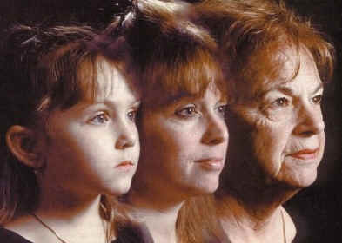
Personal Identity
Love is the substance of a person
Cannot change a person without changing their loves.
Cannot changes loves, and keep the same person, without some acceptance by old loves
The deepest love can be unchanging
This may be used to permanently identify persons
Swedenborg’s ‘inmost degree’ not normally seen?

Slide 25
Law and Divine Intervention
Physical laws describe behavior of physical degrees, if no influx from spiritual or mental
If only physical laws, matter is ‘causally closed’
But not here: Need influx into matter!
to sustain physical processes
to select and contain mental & spiritual processes
This not ‘intervention’ but intended causal influx!
Note how sustained mental and spiritual processes depend on physical selections.
The physical is the needed ‘bottom line’ for creation.

Slide 26
Preview of Fourth Talk (Feb 26)
Apply ideas and theory developed so far
Mental development (cognitive and affective)
Spiritual growth and religion
Mind-body connections
Starting the universe
Correspondences
Evolution
etc
any suggestions?
End

