Slide 1
Starting Science From God 4: Applications to Theistic Science
www.beginningtheisticscience.com
Ian Thompson
Visiting Professor of Physics, University of Surrey, England.
Currently employed at Lawrence Livermore National Laboratory.
www.ianthompson.org
Disclaimer
This material is not supported or authorized by any of the organizations or institutions at which he is employed and/or with which he is affiliated.

Slide 2
Last of series of four evenings
Titles:
Feb 5: Connecting Science and Theism (chs 1, 3)
Feb 12: Discrete Degrees (chs. 4, 5)
Feb 19: Explaining Theism (Part III)
Feb 26: Applications to Theistic Science (Part V)

Slide 3
4. Applications to Theistic Science
Topics for today:
Life on earth, and its correspondences
Mental actions
Mental growth from childhood to old age
Spiritual growth and religion
Living after old age: the afterlife
Further internet resources

Slide 4
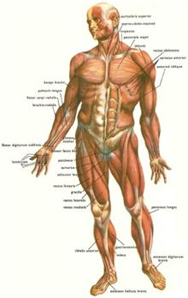
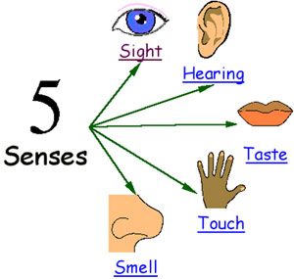
Life on Earth, and correspondences
To outline the functional forms of:
Wisdom and Light from the Sun
Ecology of plants and rationality
Ecology of energy and love
The five senses
Human body as a whole

Slide 5
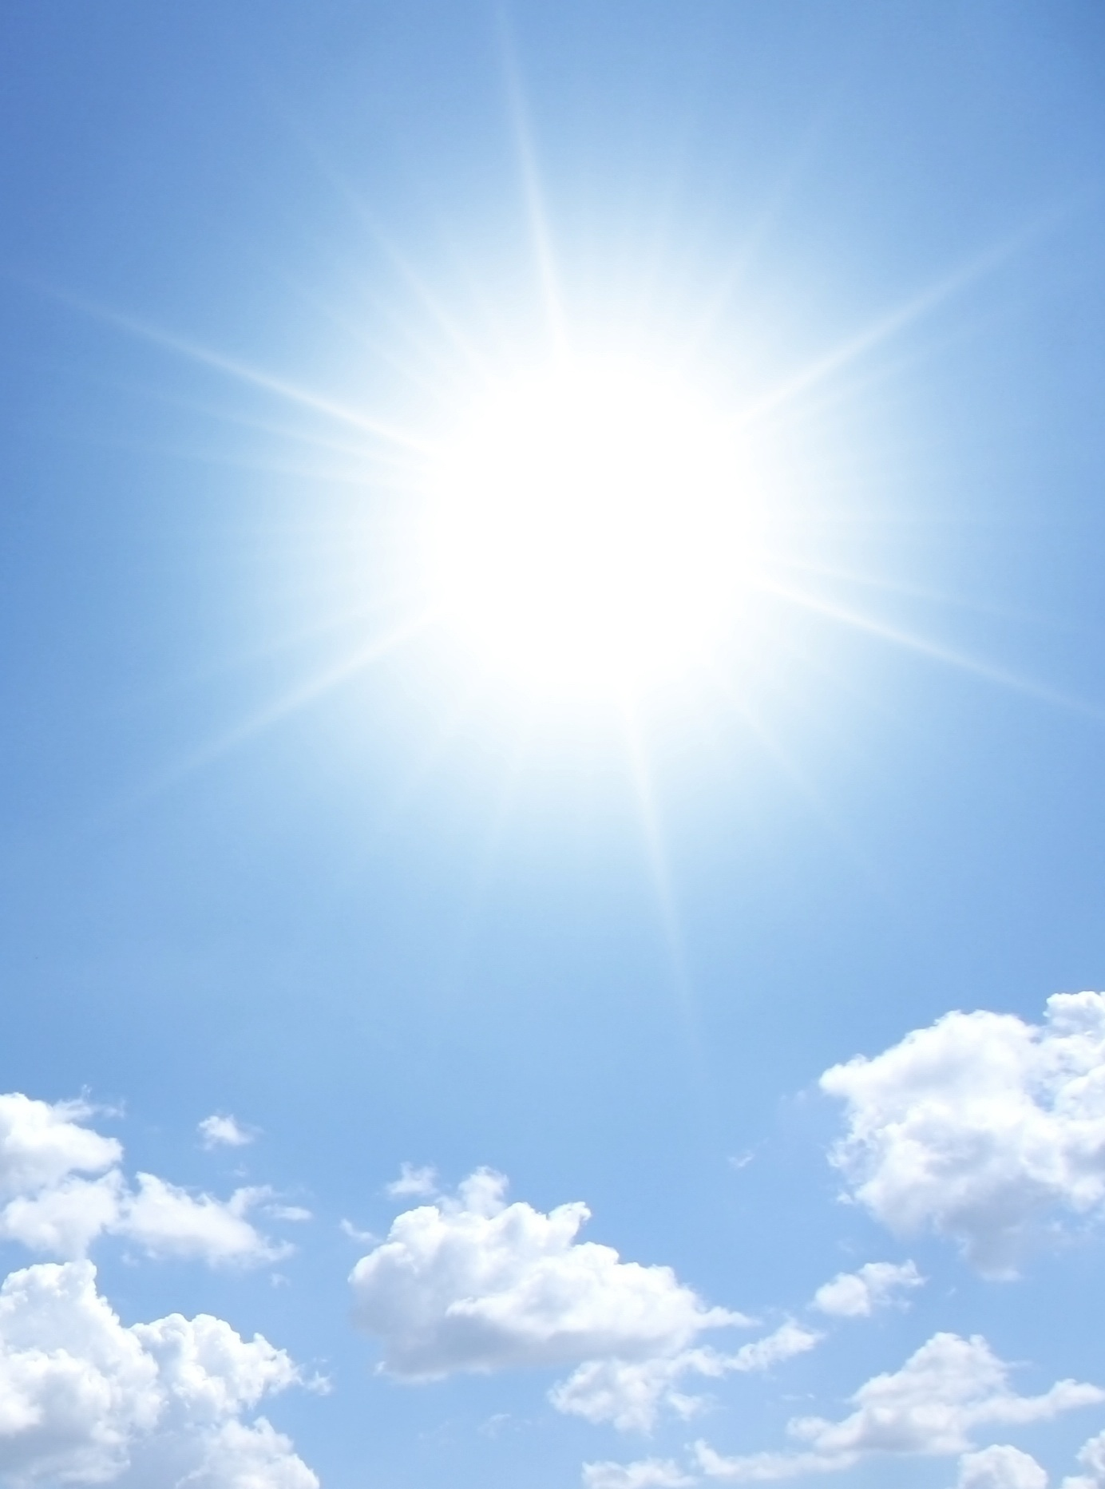
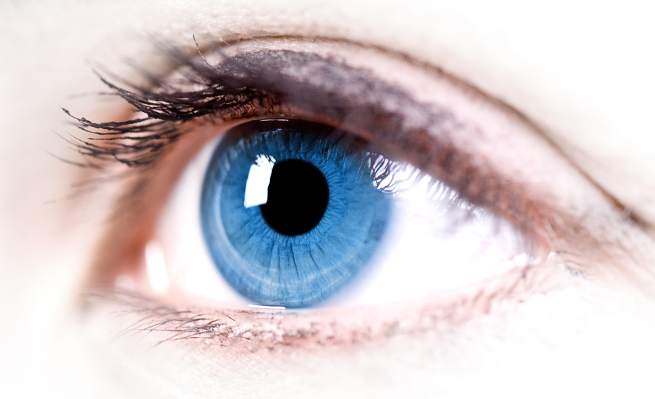
Wisdom and Light from the Sun
God is the source of wisdom to see mental things
We do not see wisdom,
But we see things in the light of wisdom
Actually we see wisdom filtered by specific ideas, and reflected into our understanding
This is like sunlight from the sun
We do not see sunlight,
But we see things in the light of sunlight
Actually we see sunlight filtered by specific objects, and reflected into our eyes
‘Eyes’ correspond to the direct use of wisdom
Insight / illumination / ‘seeing truth’ / etc

Slide 6
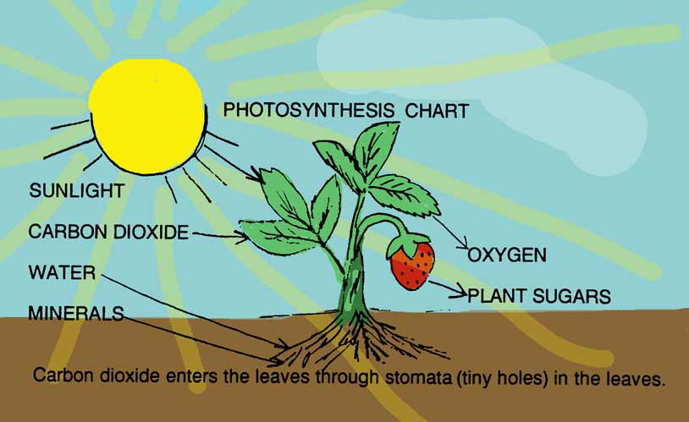
Ecology of Plants and Rationality
Sunlight is also received by plants
Wisdom is also received by our first understanding

Slide 7
Ecology of Plants and Rationality
Sunlight is also received by plants
Photosynthesis uses light to give oxygen
Oxygen spreads in our atmosphere
We breath in oxygen with our lungs
Oxygen is carried around body in blood stream
Oxygen combines with food to produce energy
Energy produces action.
Wisdom is also received by our first understanding
This uses wisdom to give rational awareness
Rational awareness spreads in spiritual air
We receive rational awareness in a second understanding within us
Rational awareness is carried around in us by mobile love
Rational awareness combines with stored loves to produce another degree of desire
Desire produces action
Conclude: plants correspond to a first rational understanding

Slide 8
Ecology of Love and Energy
We also receive energy from the Sun
This warms the earth
Plants convert some of their energy to fruit
Animal eat & digest fruit-energy for living
This is carried around body by blood, moved by means of the heart
We also receive love from God
This enlivens creation
First rational converts love into processed good
Affections ingest and using these in their life
These are moved around spiritual body by an inner love, moved by inmost love of good for good use

Slide 9
The Five Senses
Perceptions by senses:
Eyes: light from the distance
Ears: variations in the air caused by lungs of others
Nose: compounds in the air
Taste: compounds being swallowed and digested
Touch: other bodies very close
Spiritual perceptions
Eyes: wisdom from the distance
Ears: local variations from rational forms from others
Nose: good/evil in the local rationality
Taste: good/evil in good being swallowed and digested
Touch: other persons very close

Slide 10
Human body as a whole
Left-right symmetry to represent equal reception of love and wisdom, to be combined
Brain: reception & stabilization of higher levels
Lungs: reception & modulation of local rational environment
Digestive system: swallowing & digestion of local loves
Senses: reception & detection of forms (ideas) far & near.
Heart: initial power to circulate loves and rationality in body
Skeleton: general firm principles that keep our life in shape
Nervous system: spreading influence of controlling ideas
Skin: the outmost levels that contain & stabilize inner forms
Hair: beyond the outermost levels > physical actions & power
Feet: our outer levels that determine our spiritual place

Slide 11
Beginning Theistic Science
These ideas are just the beginning of a more complete Theistic Science.
We need more scientific details and predictions about
Connections between mind and brain
Functions of neural networks
Distribution of mind in all the body
Mechanisms of sensation and perception

Slide 12
Mental Actions
All mental action depends on combinations of thought and feelings:
of Love and Wisdom (if in spiritual)
of thoughts and desires (if in mental)
cognitive and affective processes (in psychology)
Metaphor: a kind of ‘marriage’ of equals
Eventually mental actions produce physical actions.

Slide 13
Mental Growth
Mental growth is the awakening of new degrees above the present consciousness
Depends first on new actions that provide framework for possible new receptions
The actions are ultimately physical.
Physical actions provide permanent changes
Then new thoughts and affections can be more persistently present & effective.

Slide 14
Spiritual growth (bad ideas)
Elevated, expanded, rotated, vibrated (etc.) consciousness: Expanding our consciousness even to the whole universe and over all time, or making it run fast or slow, does not show us what is spiritual, let alone help us regenerate.
Belief: since this is just in the understanding and does not change loves in the will.
Knowledge, even of truths (wisdom): knowledge of what is true, even of what is good, is no use unless it is used to reform the will. It is ‘faith alone’ to think that only knowledge is efficacious.
Blind obedience: obedience to truth is fruitful, but blind obedience has no input from wisdom in the understanding.
Good intentions or love: love needs wisdom in order to act for good purposes. Good intentions ‘mean well’ but often stray through lack of insight, even lack of common sense.
Suffering: suffering by itself is something that happens to us not something we do. There are many causes of suffering (natural and human); what is spiritually significant is how we respond to these.

Slide 15
Ennead (set of 9) of sub-levels
Reminder:
1: Spiritual degree love in the spirit | 2: Mental degree thoughts in mind | 3: Physical degree actions in the body
Love of loving: 1.1 | Thoughts of loves: 2.1 | Effects from ends: 3.1
Love of thoughts: 1.2 | Thoughts of thoughts: 2.2 | Effects from thoughts: 3.2
Love of actions: 1.3 | Thoughts of actions: 2.3 | Effects from actions: 3.3
Spiritual | Mental | Physical
Love of loving: 1.1 Celestial heaven | Thoughts of loves: 2.1 Interior rational | Effects from ends: 3.1 Pregeometric physics
Love of thoughts: 1.2 Spiritual heaven | Thoughts of thoughts: 2.2 Scientific rational | Effects from thoughts: 3.2 Virtual physical processes
Love of actions: 1.3 Spiritual-natural heaven | Thoughts of actions: 2.3 Exterior mind | Effects from actions: 3.3 Actual physical processes

Slide 16
Mental growth: childhood to old age
Consider just the mind:
Middle and old age
25 – years
Gowan : generative 25-40
: ego-integrity 40 –
Swedenborg: regeneration
Mental
Thoughts of loves: 2.1 Interior rational | Wisdom
Thoughts of thoughts: 2.2 Scientific rational | Understanding
Thoughts of actions: 2.3 Exterior mind | Knowledge
Thoughts of thoughts: 2.2 Scientific rational | Understanding
Thoughts of actions: 2.3 Exterior mind | Knowledge
Adolescence and youth
10 – 25 years
Piaget: operational 9-12
formal 12-18
Gowan: creative 18-25
Thoughts of actions: 2.3 Exterior mind | Knowledge
Childhood: 0 – 8 years
Piaget: sensorimotor
pre-operational
There are 3 levels in each of these, that we could discuss

Slide 17
Spiritual Growth: out of Egypt
Serious spiritual growth begins in adult life
Previously in 2.2 “scientific rational”, like Egypt
Now need to ‘open up’ to allow in spiritual light, and learn about love (day 1)
Then can be regenerated, by temptations, to make an interior rational mind (2.1x, days 2,3,4)
Spiritual growth is completed in the afterlife
Moving into the 1.x spiritual degrees (days 5,6,7)
Finding one’s best place among the spiritual loves

Slide 18
7 days of creation
Stage | External Representation | Internal process
Initial state | Without form and void | No spiritual form | 2.2
First state | Light and Darkness | Knowing good & true are higher | ➜2.1
Second state | Heavens and Earth | Separating source from oneself | 2.13
Third state | Tender grass, fruit trees | Acting from ideas, not heart | 2.12
Fourth state | Sun and moon | Love & insight begin in internal | 2.11
Fifth state | Whales in sea, birds in air | Deep principles & rising thoughts | 1.3
Sixth state | Living soul, image of God | Actions from insight: spiritual | 1.2
Seventh state | Day of rest, likeness of God | Actions from love: celestial | 1.1
Explained by Emanuel Swedenborg in Volume 1 of “Arcana Coelestia” (‘Secrets of Heaven’)

Slide 19
The Afterlife: living after old age
During our life, we are building up
actions in the
thoughts and affections in the
At death, we lose body in the physical degree
How can we still function, with only love & mind?
What actions still keep our loves = personality?
physical degree
mental degree
Spiritual | Mental | Physical
Love of loving: 1.1 Celestial heaven | Thoughts of loves: 2.1 Interior rational | Effects from ends: 3.1 Pregeometric physics
Love of thoughts: 1.2 Spiritual heaven | Thoughts of thoughts: 2.2 Scientific rational | Effects from thoughts: 3.2 Virtual physical processes
Love of actions: 1.3 Spiritual-natural heaven | Thoughts of actions: 2.3 Exterior mind | Effects from actions: 3.3 Actual physical processes
Spiritual | Mental
Love of loving: 1.1 Celestial heaven | Thoughts of loves: 2.1 Interior rational
Love of thoughts: 1.2 Spiritual heaven | Thoughts of thoughts: 2.2 Scientific rational
Love of actions: 1.3 Spiritual-natural heaven | Thoughts of actions: 2.3 Exterior mind

Slide 20
Determining the Afterlife
What seems to be important here:
spiritual loves (1.1)
interior rational ideas/doctrine (2.1)
‘inner physical’ substances (3.1 = ‘limbus’) (?)
Thoughts and sensations follow from the loves
Not determined by present physical events any more
Spiritual | Mental | Physical
Love of loving: 1.1 Celestial heaven | Thoughts of loves: 2.1 Interior rational | Effects from ends: 3.1 Pregeometric physics
Love of thoughts: 1.2 Spiritual heaven | Thoughts of thoughts: 2.2 Scientific rational | Effects from thoughts: 3.2 Virtual physical processes
Love of actions: 1.3 Spiritual-natural heaven | Thoughts of actions: 2.3 Exterior mind | Effects from actions: 3.3 Actual physical processes
Love of loving: 1.1 Celestial heaven | Thoughts of loves: 2.1 Interior rational
Love of loving: 1.1 Celestial heaven | Thoughts of loves: 2.1 Interior rational | Effects from ends: 3.1 Pregeometric physics
Love of loving: 1.1 Celestial heaven

Slide 21
What to do in the Afterlife?
Afterlife people have love and minds, but no physical body.
Earth people have minds and body, but spiritual loves only gradually developing
Would be frustrating in afterlife to have love and ideas, but no possibility of ultimate physical action!
So a clever combination:
Afterlife people receive spiritual loves and generate new ideas
Earth people receive new ideas, and then act physically.
That is:
the spiritual worlds supply the first stages, and we on earth carry it on to ultimate physical actions.
We all do something useful, and everyone enjoys the process.

Slide 22
The End
We have discussed:
New way of connecting God and theism
New ideas of cause and discrete degrees
Using discrete degrees to understand Theism
Application to human life and growth
Lots more possible details for
physics, psychology, spiritual life.
religion, scriptures, history of religions, the incarnation, …

Slide 23
Further Resources
Websites by Ian Thompson: www.ianthompson.org
Beginning Theistic Science, for the book “Starting Science From God”, at www.beginningtheisticscience.com
Theistic Science at www.theisticscience.org
Swedenborg’s writings at www.e-swedenborg.com
Articles about Swedenborg at www.swedenborgstudy.com
Bible Meanings at www.biblemeanings.info
‘7 days of creation’ at 7daysofcreation.info
Mind & body at www.newdualism.org
Physical and multilevel causes at www.generativescience.org

Slide 25
Mental growth: childhood to old age
Mental | equals:
Thoughts of loves: 2.1 Interior rational | Wisdom
Thoughts of thoughts: 2.2 Scientific rational | Understanding
Thoughts of actions: 2.3 Exterior mind | Knowledge
Consider just
the mental
degree:
Now expand into its sub-sub-sub-degrees:
Mental
Wis of thoughts of love: 2.1.1 Celestial heaven | Thoughts of loves: 2.1 Interior rational | Effects from ends: 3.1 Pregeometric physics
Love of thoughts: 1.2 Ideological/Philosophical | Thoughts of thoughts: 2.2 Formal | Effects from thoughts: 3.2 Operational
Love of actions: 1.3 Preoperational | Thoughts of actions: 2.3 | Thoughts of effects from actions: 3.3 Sensorimotor mind

Slide 26
Love of loving: 1.1 Celestial heaven
Love of loving: 1.1 Celestial heaven | Thoughts of loves: 2.1 Interior rational
Love of loving: 1.1 Celestial heaven | Thoughts of loves: 2.1 Interior rational | Effects from ends: 3.1 Pregeometric physics
Spiritual | Mental
Love of loving: 1.1 Celestial heaven | Thoughts of loves: 2.1 Interior rational
Love of thoughts: 1.2 Spiritual heaven | Thoughts of thoughts: 2.2 Scientific rational
Love of actions: 1.3 Spiritual-natural heaven | Thoughts of actions: 2.3 Exterior mind

